Slide 1
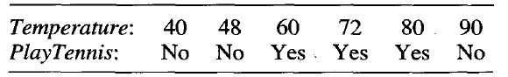
Correction (by 黃文杰)
Entropy before split
Info(D) = I(3,3) = 1
Use “54” to split
Gain(T=54) = Info(D) – Info_{T=54}(D) = 1 – [(2/6) I(0,2) + (4/6) I(3,1)] = 1 – (4/6)(0.811) = 0.46
Use “85” to split
Gain(T=85) = Info(D) – Info_{T=85}(D) = 1 – [(5/6) I(3,2) + (1/6) I(0,1)] = 1 – (5/6) 0.97 = 0.19
Use “T>=54?” as the splitting criteria

Slide 2
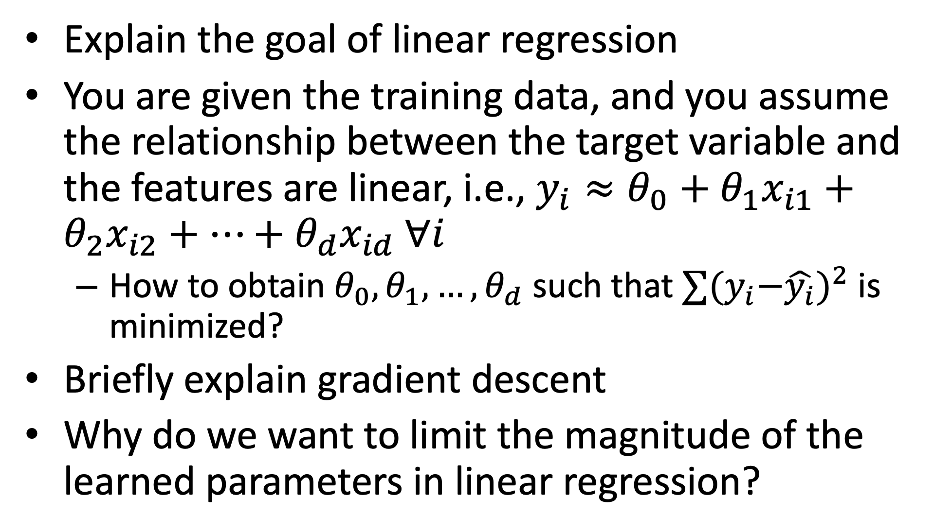
Review quizzes (1/3)
Explain the goal of linear regression
You are given the training data, and you assume the relationship between the target variable and the features are linear, i.e., $y_{i}≈θ_{0}+θ_{1}x_{i1}+θ_{2}x_{i2}+…+θ_{d}x_{id} ∀i$
How to obtain $θ_{0},θ_{1},…,θ_{d}$ such that $∑{{(y}_{i}−\hat{y_{i}})}^{2}$ is minimized?
Briefly explain gradient descent
Why do we want to limit the magnitude of the learned parameters in linear regression?

Slide 3
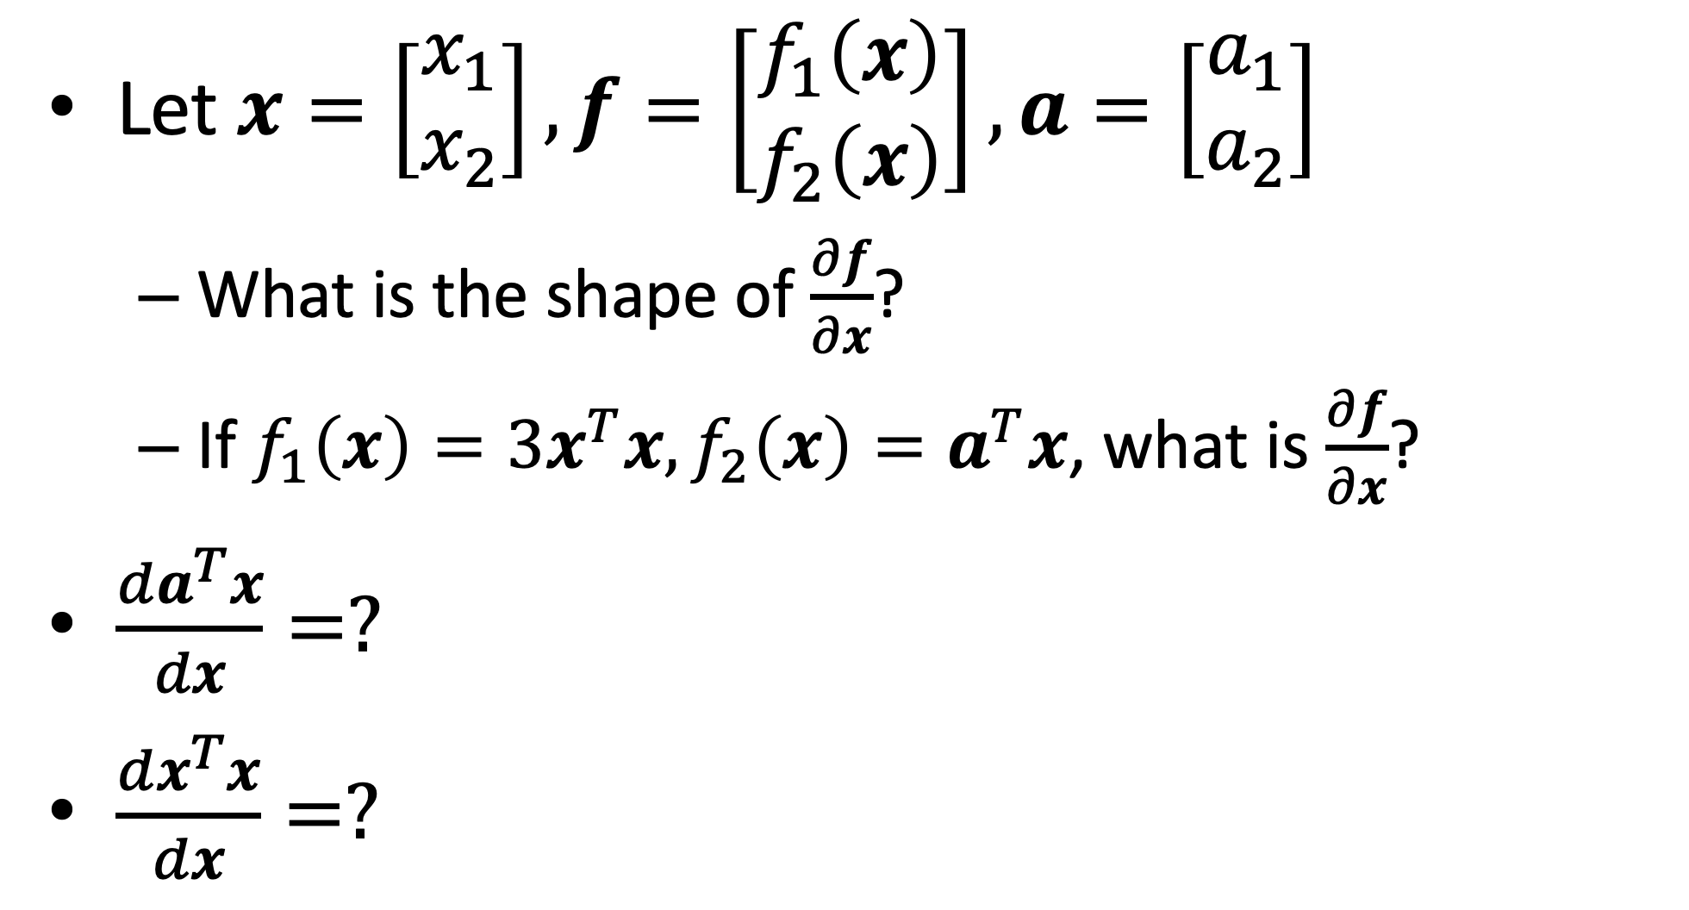
Review quizzes (2/3)
Let $x=\left[\begin{matrix}x_{1} \\ x_{2}\end{matrix}\right], f=\left[\begin{matrix}f_{1}\left(x\right) \\ f_{2}\left(x\right)\end{matrix}\right],a=\left[\begin{matrix}a_{1} \\ a_{2}\end{matrix}\right]$
What is the shape of $\frac{∂f}{∂x}$?
If $f_{1}\left(x\right)=3x^{T}x, f_{2}\left(x\right)=a^{T}x$, what is $\frac{∂f}{∂x}$?
$\frac{da^{T}x}{dx}=?$
$\frac{dx^{T}x}{dx}=?$

Slide 4
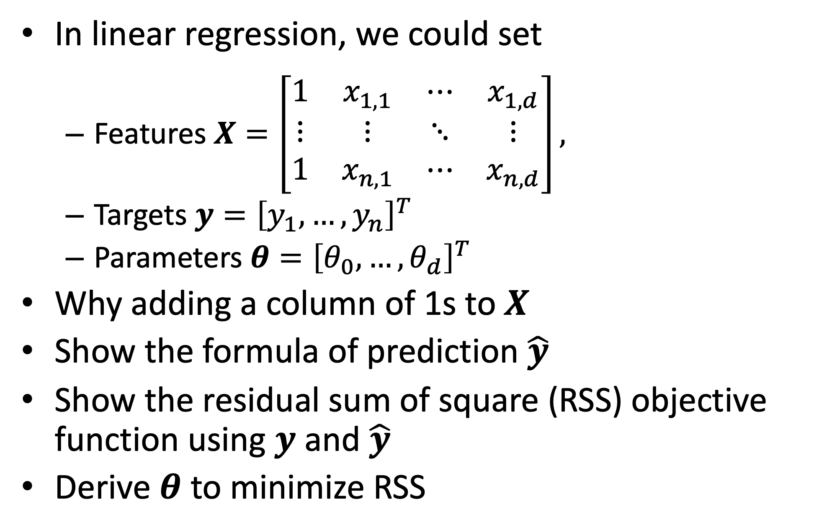
Review quizzes (3/3)
In linear regression, we could set
Features $X=\left[\begin{matrix}1 & x_{1,1} & ⋯ & x_{1,d} \\ ⋮ & ⋮ & ⋱ & ⋮ \\ 1 & x_{n,1} & ⋯ & x_{n,d}\end{matrix}\right],$
Targets $y={\left[y_{1},…,y_{n}\right]}^{T}$
Parameters $θ={\left[θ_{0},…,θ_{d}\right]}^{T}$
Why adding a column of 1s to $X$
Show the formula of prediction $\hat{y}$
Show the residual sum of square (RSS) objective function using $y$ and $\hat{y}$
Derive $θ$ to minimize RSS

Slide 5
Review quizzes
What is regularization terms and why do we need them?
What is Lasso?
What is Ridge regression?
Compared to Ridge regression, why does Lasso tend to shrink some parameters to zero?

Slide 6
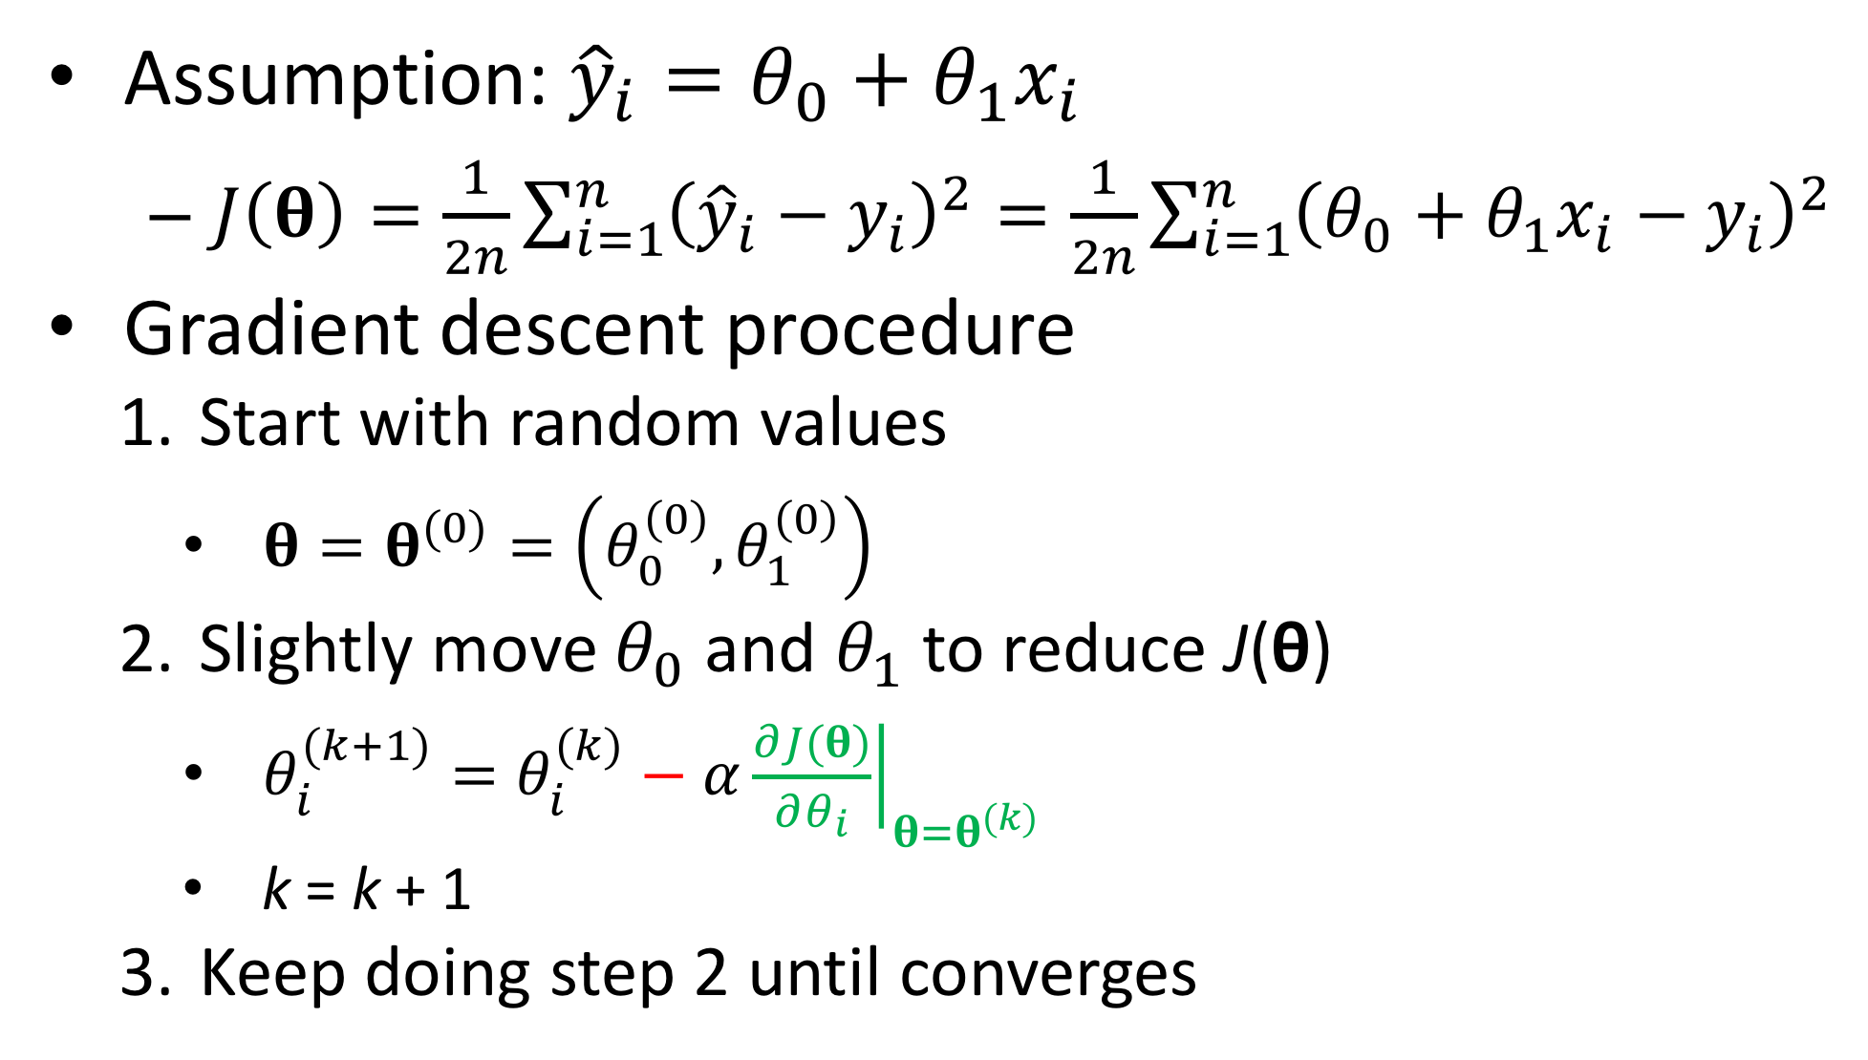
A toy example of gradient descent for linear regression
Assumption: ${\hat{y}}_{i}=θ_{0}+θ_{1}x_{i}$
$J\left(θ\right)=\frac{1}{2n}\sum_{i=1}^{n}{{\left({\hat{y}}_{i}−y_{i}\right)}^{2}}=\frac{1}{2n}\sum_{i=1}^{n}{{\left(θ_{0}+θ_{1}x_{i}−y_{i}\right)}^{2}}$
Gradient descent procedure
Start with random values
$θ=θ^{(0)}=\left(θ_{0}^{\left(0\right)},θ_{1}^{\left(0\right)}\right)$
Slightly move $θ_{0}$ and $θ_{1}$ to reduce J(θ)
$θ_{i}^{(k+1)}=θ_{i}^{(k)}−α{\left.\frac{∂J(θ)}{∂θ_{i}}\right|}_{θ=θ^{(k)}}$
k = k + 1
Keep doing step 2 until converges

Slide 7
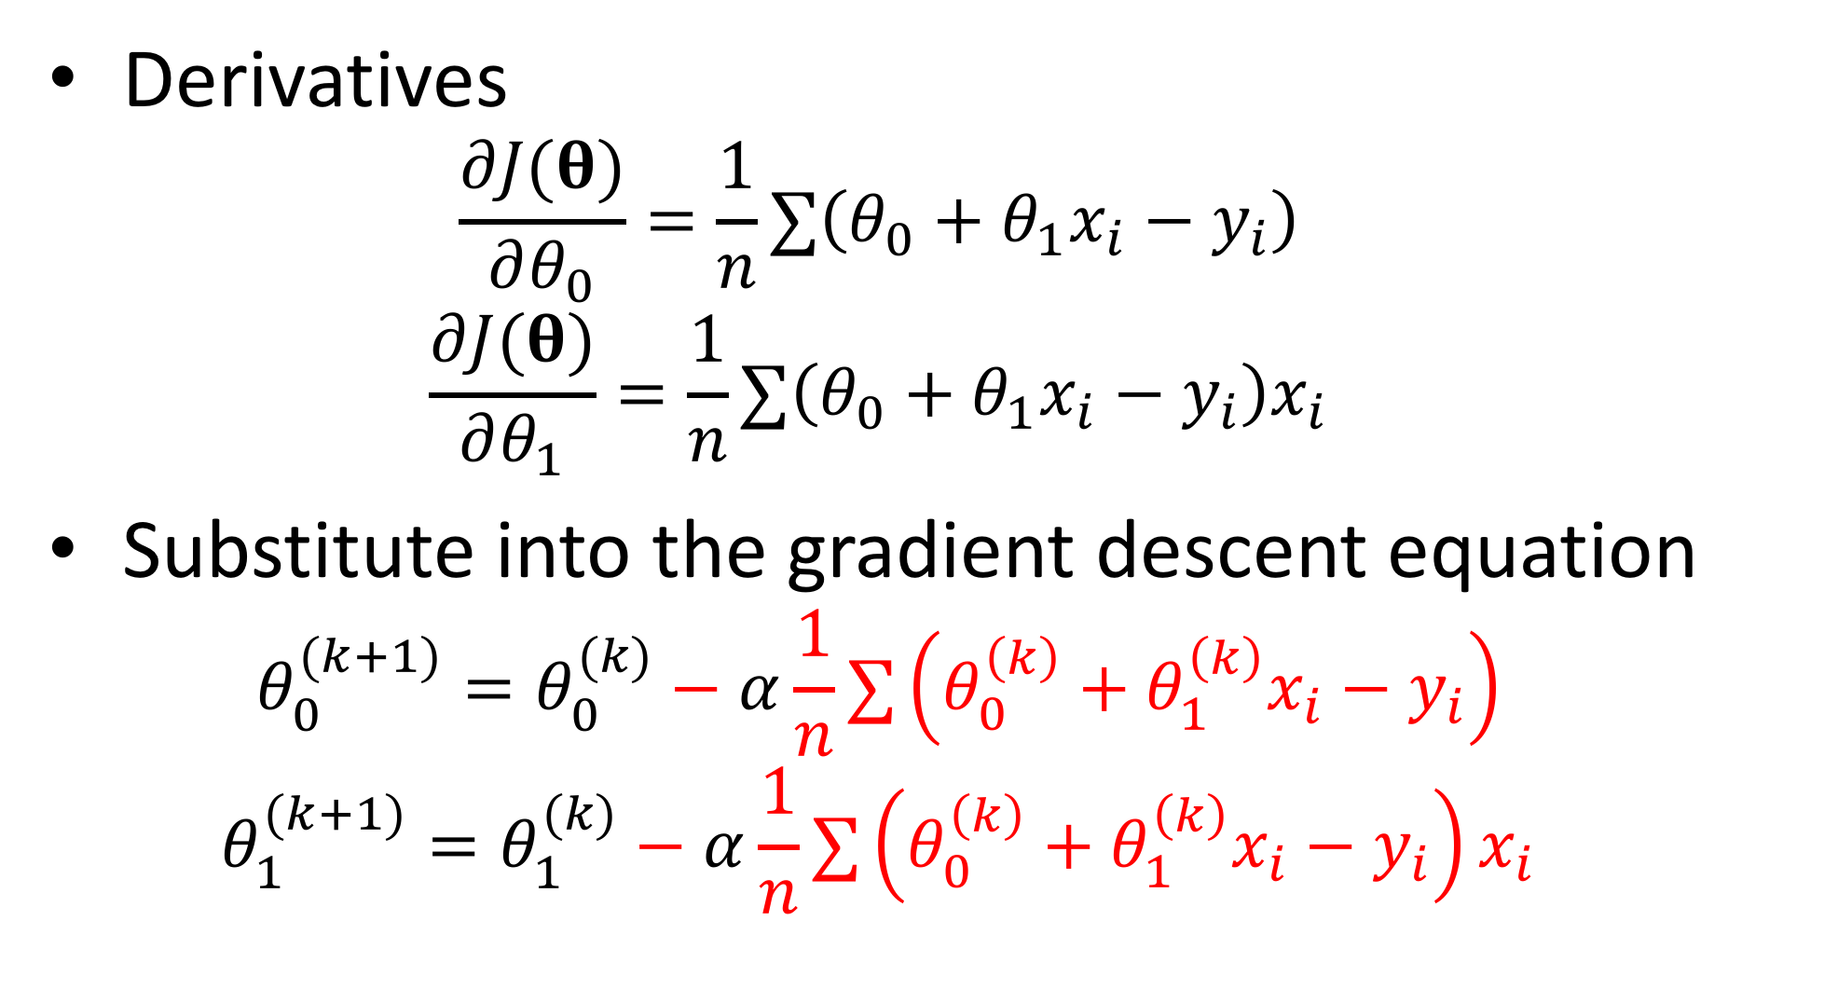
A toy example of gradient descent for linear regression (cont’)
Derivatives
$$\frac{∂J(θ)}{∂θ_{0}}=\frac{1}{n}∑\left(θ_{0}+θ_{1}x_{i}−y_{i}\right)$$
$$\frac{∂J(θ)}{∂θ_{1}}=\frac{1}{n}∑\left(θ_{0}+θ_{1}x_{i}−y_{i}\right)x_{i}$$
Substitute into the gradient descent equation
$$θ_{0}^{(k+1)}=θ_{0}^{(k)}−α\frac{1}{n}∑\left(θ_{0}^{\left(k\right)}+θ_{1}^{\left(k\right)}x_{i}−y_{i}\right)$$
$$θ_{1}^{(k+1)}=θ_{1}^{(k)}−α\frac{1}{n}∑\left(θ_{0}^{\left(k\right)}+θ_{1}^{\left(k\right)}x_{i}−y_{i}\right)x_{i}$$

Slide 8
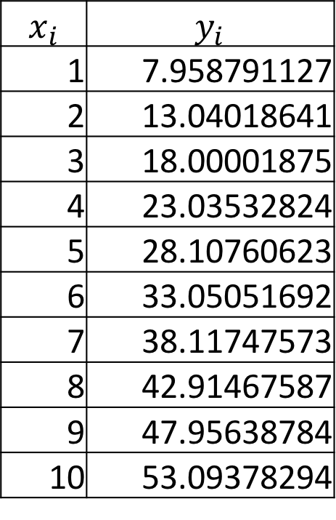
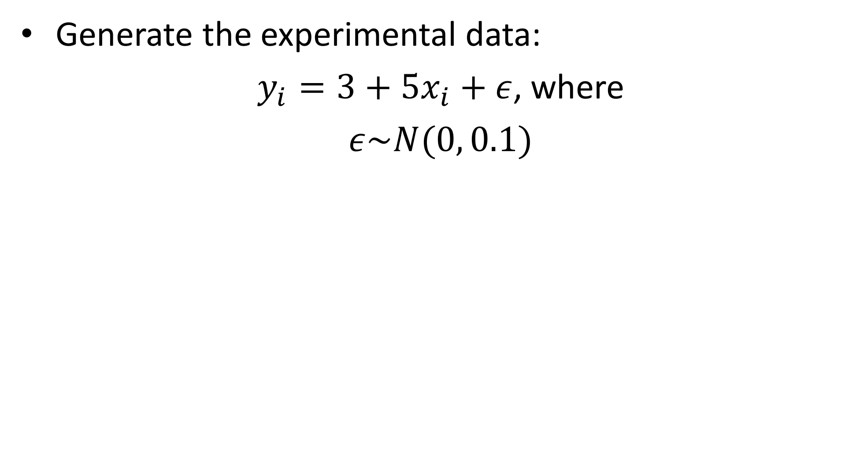
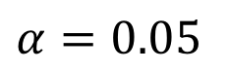
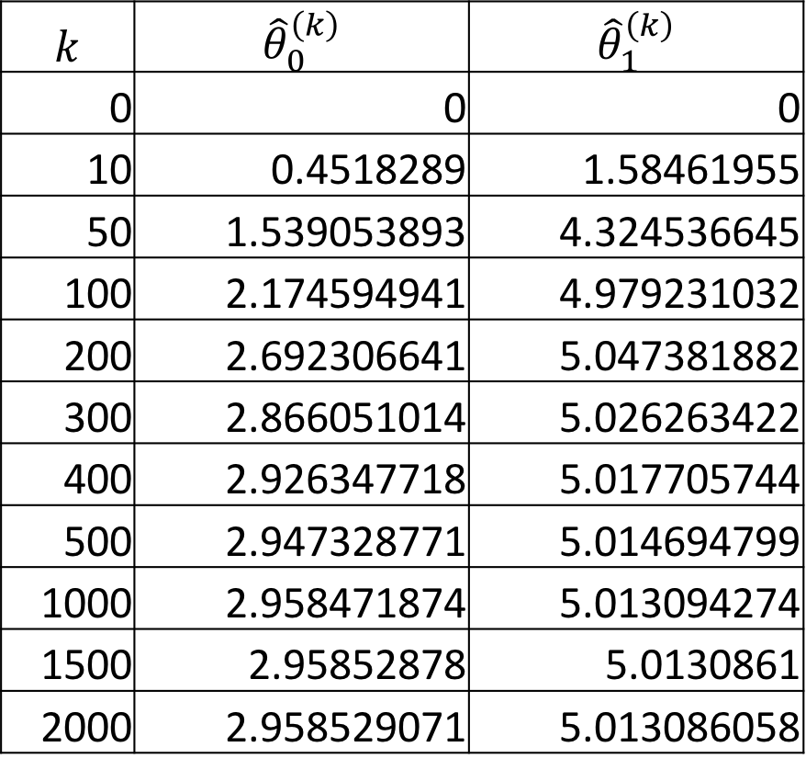
A toy example of gradient descent for linear regression (cont’)
Generate the experimental data:
$y_{i}=3+5x_{i}+ε$, where
$ε\sim N(0, 0.1)$
$$x_{i}$$ | $$y_{i}$$
1 | 7.958791127
2 | 13.04018641
3 | 18.00001875
4 | 23.03532824
5 | 28.10760623
6 | 33.05051692
7 | 38.11747573
8 | 42.91467587
9 | 47.95638784
10 | 53.09378294
$$k$$ | $${\hat{θ}}_{0}^{\left(k\right)}$$ | $${\hat{θ}}_{1}^{\left(k\right)}$$
0 | 0 | 0
10 | 0.4518289 | 1.58461955
50 | 1.539053893 | 4.324536645
100 | 2.174594941 | 4.979231032
200 | 2.692306641 | 5.047381882
300 | 2.866051014 | 5.026263422
400 | 2.926347718 | 5.017705744
500 | 2.947328771 | 5.014694799
1000 | 2.958471874 | 5.013094274
1500 | 2.95852878 | 5.0130861
2000 | 2.958529071 | 5.013086058
$$α=0.05$$

Slide 9
Gradient descent by Excel

Slide 10
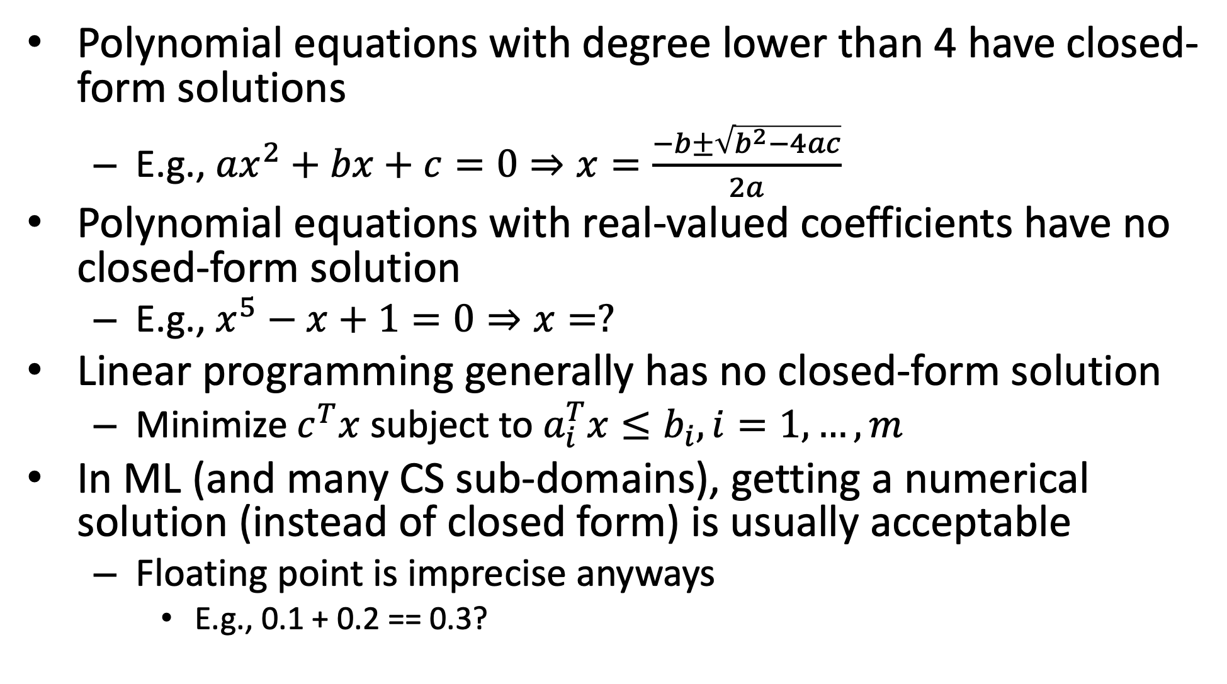
Most equations have no closed form solution
Polynomial equations with degree lower than 4 have closed-form solutions
E.g., $ax^{2}+bx+c=0⇒x=\frac{−b±\sqrt{b^{2}−4ac}}{2a}$
Polynomial equations with real-valued coefficients have no closed-form solution
E.g., $x^{5}−x+1=0⇒x=?$
Linear programming generally has no closed-form solution
Minimize $c^{T}x$ subject to $a_{i}^{T}x≤b_{i}, i=1,…,m$
In ML (and many CS sub-domains), getting a numerical solution (instead of closed form) is usually acceptable
Floating point is imprecise anyways
E.g., 0.1 + 0.2 == 0.3?

Slide 11
Mid-term presentation
Reminder: midterm project proposal on 11/9
Remember to attend physically
If you want to apply ML on certain topic, the presentation may include (but not limit to)
Introduction
Background knowledge
The motivation of your project
The overall vision/goal of your project
Dataset
What is your target dataset
How to collect the dataset
Current progress
E.g., naïve method(s) as baseline solution(s)
A plan/schedule for the following weeks
What do you expect to accomplish by the end of the semester
If you want to develop a new method, you may include
Motivation
Current ideas
You may use any tools you want (you don’t need to start from scratch)
The TAs will announce the presentation sequence

